Slide 1
BLOCKCHAIN
Related Data Structures and Concepts
Pr. TMIMI Mehdi

Slide 2
Main goal
Discuss :
Dive deeply into how exactly hashing works
How digital signatures work
Make a real live functioning cryptocurrency

Slide 3


Bad Hash
=> Recall that hash functions should compress any arbitrary string data into a fixed-size output.
=> also recall our initial attempt "Bad Hash":
Concert each character into a corresponding value, sum them up modulo size of output
Variety of problems with this scheme

Slide 4
Merkle-Damgård Transforms
'Merkle-Damgård transforms' solve some of the problems converting arbitrary "input to fixed output" using a very similar process to a blockchain!
Chunks data into blocks (padding if necessary)
Accepts result of previous blocks along with current block to produce a new output:
Compression algorithm accepts two argument: current block (size m) and previous result (size n)
Outputs result of size n (where n < m )
Can repeat as many times as needed.
Notes:
The Merkle-Damgård construction is a scheme to design collision-resistant cryptographic hash functions. The scheme uses one-way compression functions that are collision-resistant. The original message is extended so it has a size of a specific multiple (i.e. 512 or 1024). The message is then divided into blocks (512 bits or 1024 bits). Then, we apply the compression function to each block and an input vector iteratively. Lastly, we apply a finalization function to the modified input vector and the output is the hash value (also called a message digest).

Slide 5
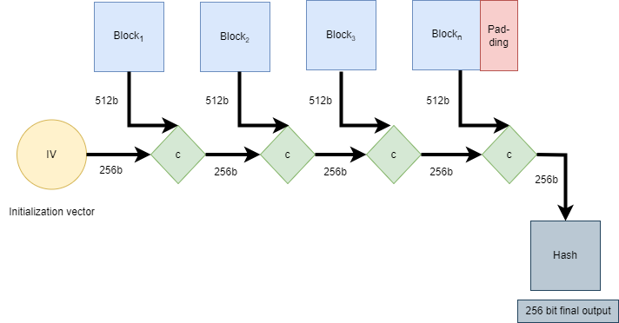
Notes:
Initialization vector: Constant defined for each hash algorithm as the initial input
C: compression function

Slide 6

Digital Signatures
We have already discussed how cryptographic hashes can be used to hide information
We can also use them to prove our identity using digital signatures

Slide 7
Characteristics of Digital Signatures
Only I can make a signature, but anyone can verify its validity.
The signature cannot be re-used - it is tied to a specific document (= set of bits)
Signature creation does NOT have to be deterministic!
Note this is more powerful than a hand-written signature which can be easily forged, cannot be easily validated, and can be re-used!

Slide 8
Digital Signature Scheme = Three Algorithms
To create a digital scheme to meet all of these characteristics:
(sk, pk) = generateKeys(keysize)
Given a keysize, return a "keypair": one is public used for verification and a secret key for signing.
sig = sign(sk, message)
Given a secret key sk and a message, return a signature for that message.
IsValid = verify(pk, message, sig)
Given a public key, a message, and a signature, return a Boolean value indicating
whether or not the message was properly signed

Slide 9
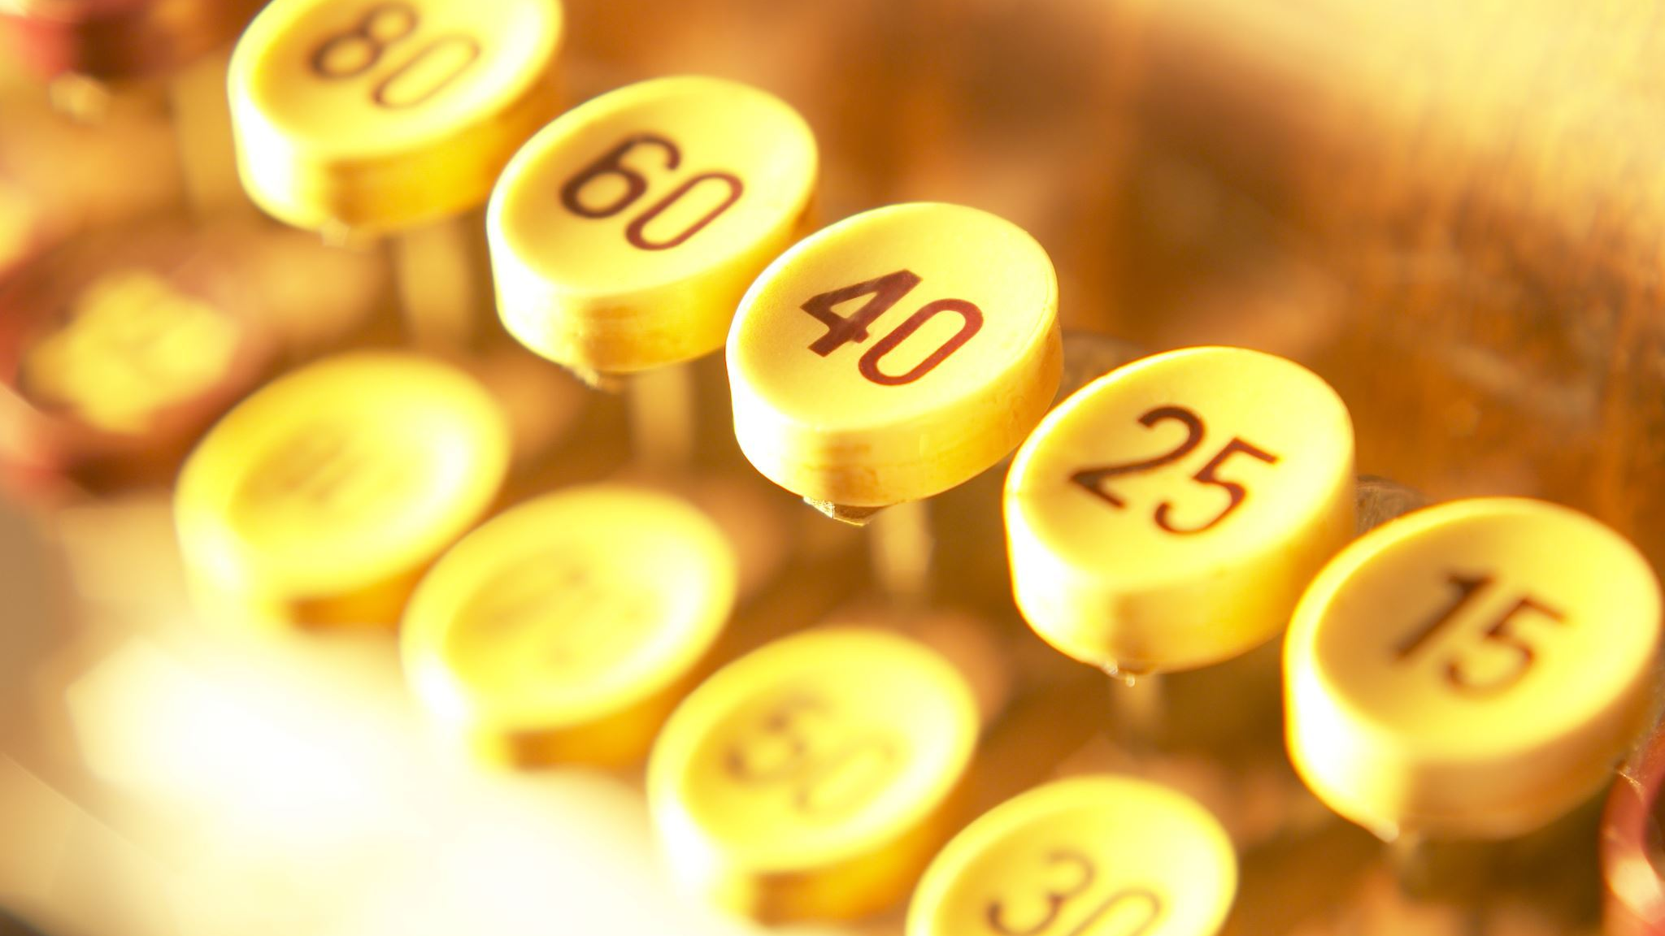
Key=identity
Now that I can always prove that I am me => I have an identity
If I want a new Identity => just generate a new keypair
If someone wants to impersonate me, it should be computationally infeasible

Slide 10
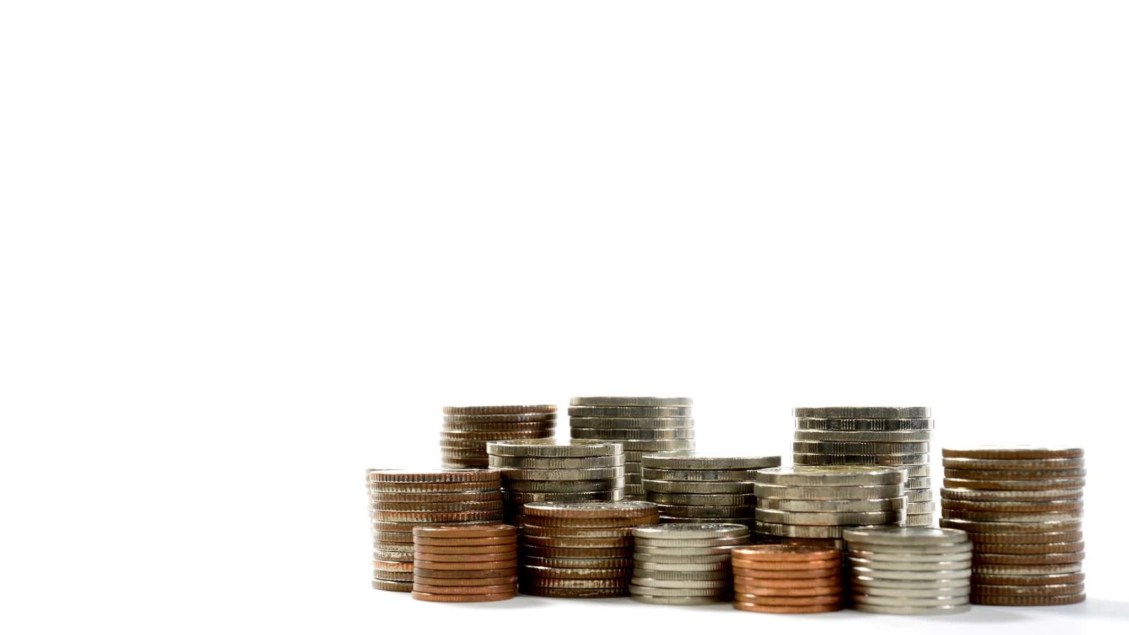
GoofyCoin
One entity (Goofy) can create a new coin => all new coins belong to Goofy
Whoever owns a coin can transfer it to somebody else
=> Both of these rules can be implemented using cryptographic operations

Slide 11
Generating coins
Goofy generate a unique coin ID 'u'
Goofy computes a digital signature s with his secret key
u||s => is a coin
Anyone can verify(pk, u ,s) to determine if a coin is valid

Slide 12
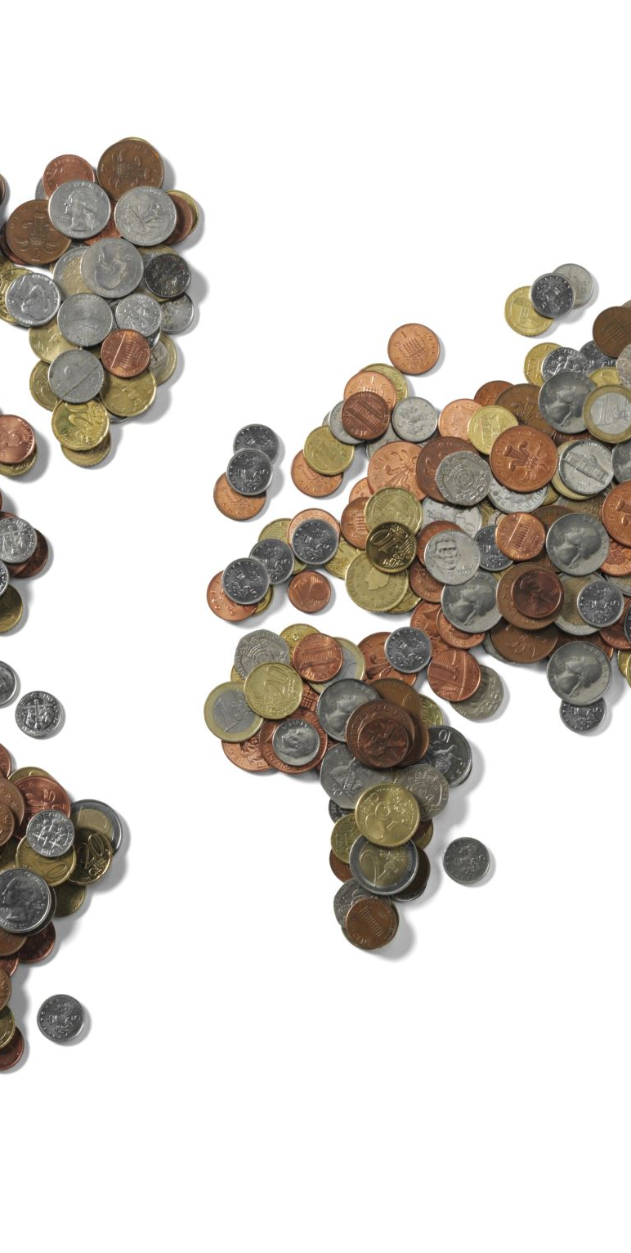
Transactions (Transferring coins) 1/2
Goofy creates a new transaction "Give this to Mehdi"
Then Goofy signs that transaction using his private key
Anyone can verify that Goofy generated the coin and it was transferred to Mehdi
=> this is a hash pointer to a coin
=> Mehdi is Mehdi's public key

Slide 13
Transactions (Transferring coins) 2/2
Since Mehdi's public key is specified in the transaction, if Mehdi tries to send the coin to someone else, he will need to sign this new transaction with his private key.
Anyone can verify that the private key used to sign this new transaction someone matches the public key used to give the coin to her.

Slide 14
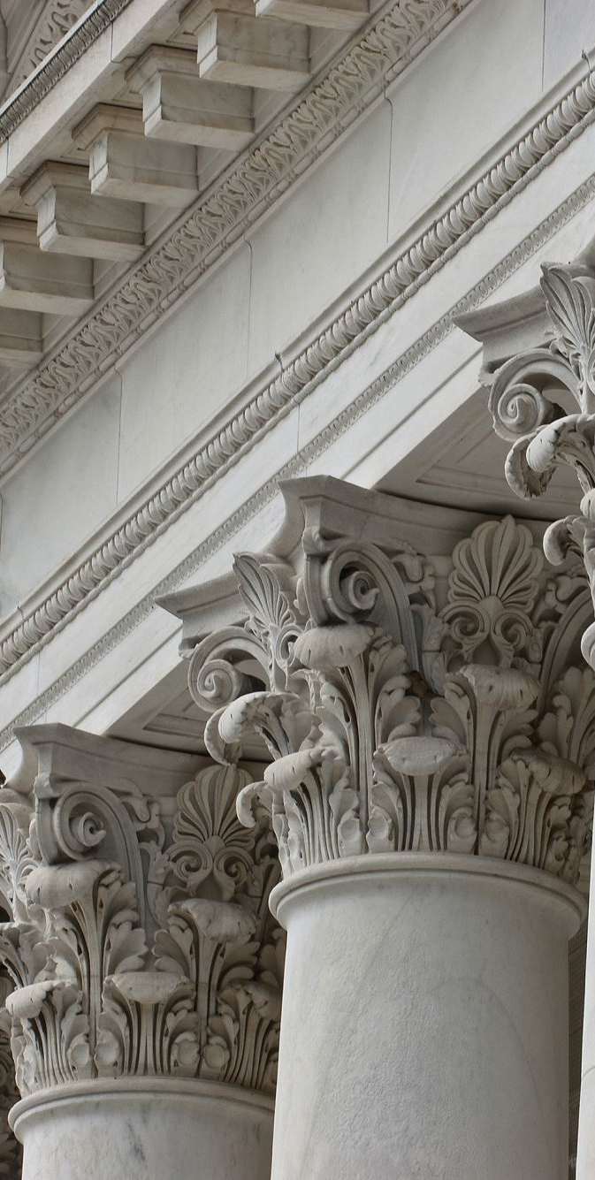
The GoofyCoin Ecosystem
Goofy can generate an infinite amount of new coins.
Whoever owns a coin can transfer it by saying and signing "Give this to the person with public key X"
Anybody can verify by following the "chain of ownership" back to Groofy.

Slide 15

Example
=> Generate a coin and then make further transactions

Slide 16
Problem!
What If Mehdi gave a coin to Sarah but neither Mehdi or Sarah have told anyone?
And Then Mehdi also give that coin to Ali.
=>Double-spending attack

Slide 17
ScroogeCoin!
Transactions occurs just as in GoofyCoin
ScroogeCoin also creates an append-only ledger (blockchain) where people can verify that a coin transfer is "official".
ScroogeCoin determines first that a transaction is valid (signed and there is no double-spend) and then signs the block.
=> Transactions that are not recorded on Scrooge's blockchain are not official

Slide 18
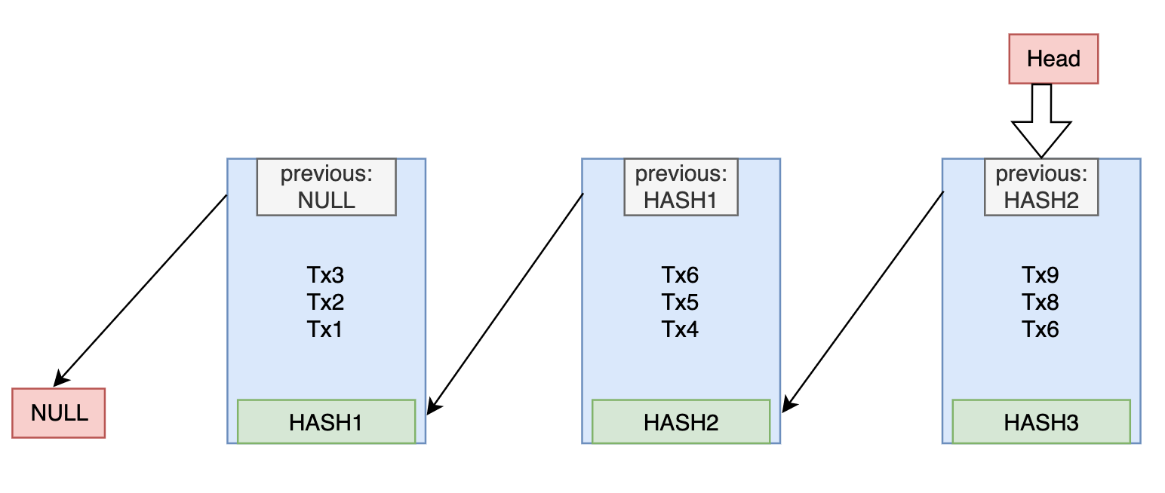
ScroogeCoin BlockChain

Slide 19
Trust
=> ScroogeCoin Works only if we trust Scrooge
Scrooge can't steal coins (he does not know the private keys of individuals)
But he can:
Blacklist coins or users.
Create new coins for himself
Stop updating the ledger (blockchain) => hold the entire system hostage

Slide 20
Centralization
=> So far, technical challenges have been minimal – earlier cryptocurrencies got to approximately this far, but all relied on some centralized intermediary.
=> How do we come to consensus of valid transactions without a central/coordinating entity ?

Slide 21
Decentralization
We need to figure out a way:
For users to agree on a single, published and authoritative blockchain.
For users to agree on what transactions are valid and official.
IDs to be assigned in a decentralized way.
Minting (creating) of coins must be done in a decentralized way.

Slide 22
BLOCKCHAIN
Related Data Structures and Concepts
Pr. TMIMI Mehdi

